Slide 1
SHMS GO Team
Business Meeting #2
Where we are – Where we’re going

Slide 2


Where We Are
Our strategic plan is the guide for the work we’re doing in the school. By monitoring the plan and ranking priorities, we can all work towards the common goals. Using the priorities in the strategic plan, the school leadership team developed a Continuous Improvement Plan (CIP) for the current school year.

Slide 3
Timeline for GO Teams
You are HERE
Fall 2021
GO Team Developed 2021-2025 Strategic Plan
1
Summer 2024
School Leadership completed Needs Assessment and defined overarching needs for SY22-23
2
August 2024
School Leadership completed 2024-2025 Continuous Improvement Plan
3
Sept. – Dec. 2024
Utilizing current data, the GO Team will review & possibly update the school strategic priorities and plan
4
Before Winter Break
GO Team will take action (vote) on the rank of the strategic plan priorities for SY24-25 in preparation for budget discussions.
5

Slide 4
Discussion Items
Current Strategic Plan
Georgia Milestones Math Data
Continuous Improvement Plan
Needs Assessment
SMART GOALS
Action Plan
Strategic Plan Alignment & Update

Slide 5
Current
Strategic Plan
2021-2025

Slide 6
Our Strategic Plan

Slide 7
Data

Slide 8
GA Milestones Math Results
If not presented at a previous GO Team meeting
Before Presenting to your GO Team:
Insert School’s 2024 GMAS Math Results – use as many slides as necessary

Slide 9

GO Team Discussion:
Data Protocol
What do you notice?
What are your wonderings?
Based on our school’s trend data from MAP assessments and end-of-year test assessments, which student sub-groups and grade levels showed the most significant gaps or unexpected trends?
Based on our school’s trend data from MAP assessments, Milestones and other indicators, are there specific trends that require more focused attention?
What additional questions do you have?

Slide 10
Continuous Improvement Plan

Slide 11
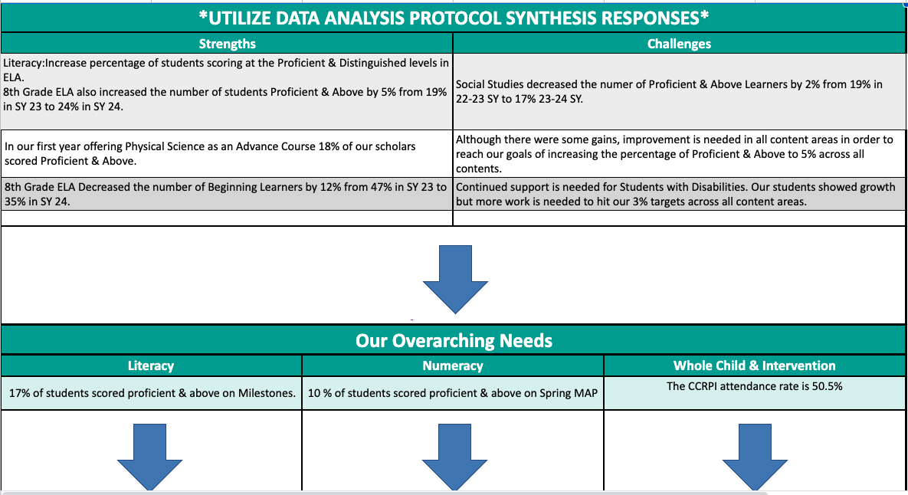
Sylvan Hills Middle School
Needs Assessment
Notes:
Notes for School CIP Teams: After completing your Comprehensive Needs Assessment ( data protocol), you will come here and identify some strengths and opportunities/challenges you have observed from the data. The priority areas are Literacy, Numeracy, and Whole Child & Student Support. Identify an overarching need for each area. Formulate a problem statement for each area. Make sure the problem statement meets the criteria. Refer to your CIP resources.

Slide 12
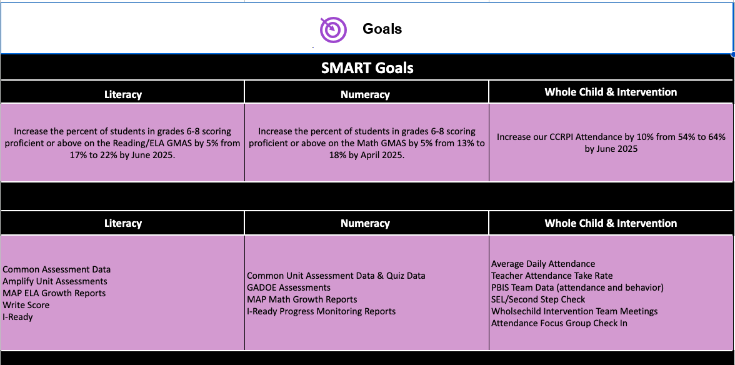

Slide 13
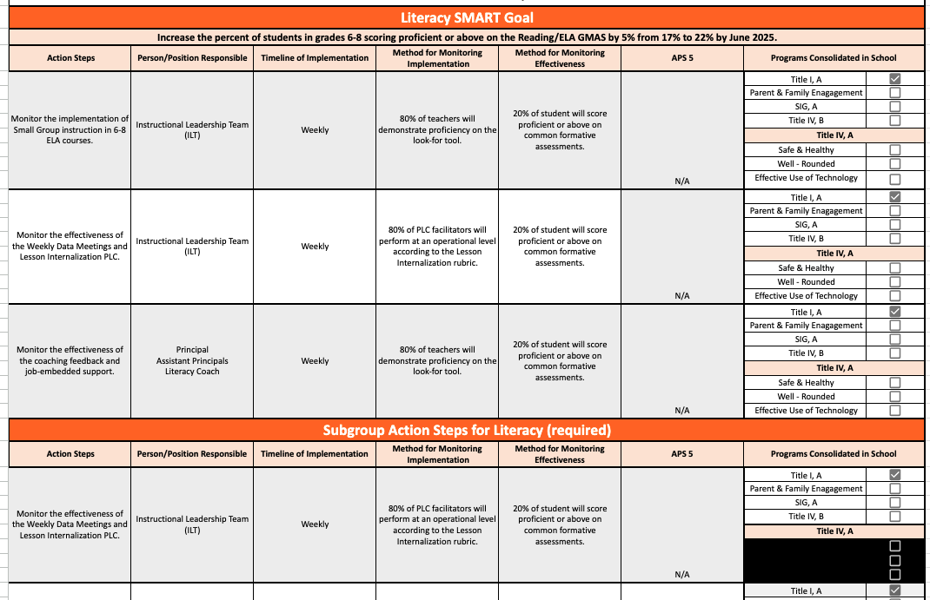

Slide 14
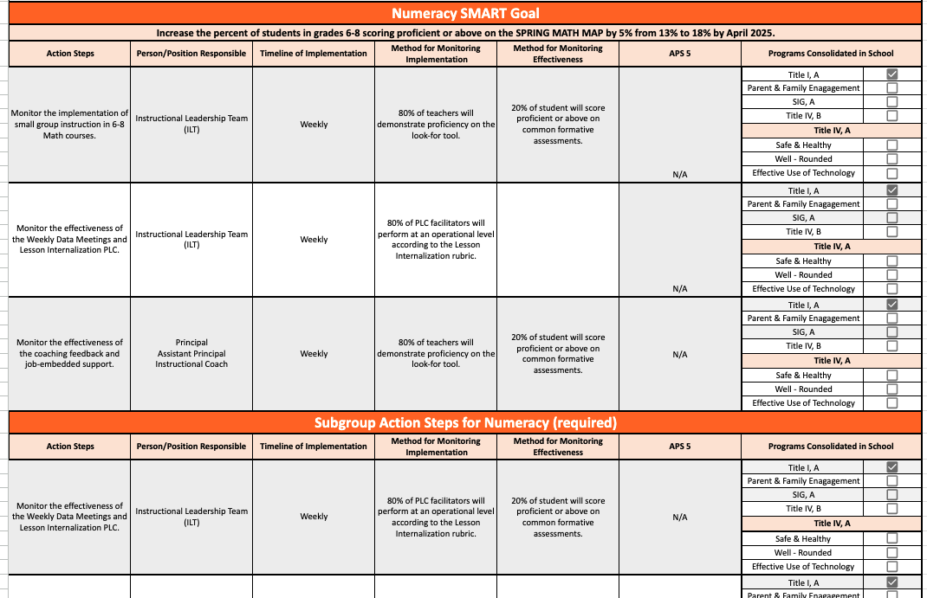

Slide 15
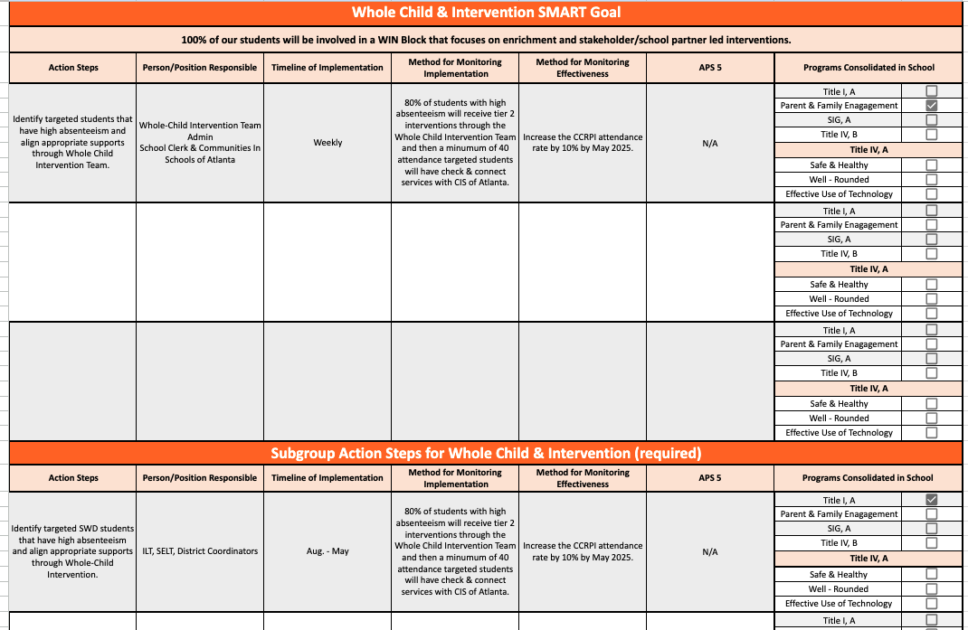

Slide 16
GO Team
Activity
&
Discussion
GO TEAM DISCUSSION: Review the priorities and goals in your strategic plan and the information and goals CIP. Reflect on if updates need to be made to the Strategic Plan.
Are all CIP Goals reflected in
our Strategic Plan Priorities?
If not, which CIP Goal(s) are missing and should be added to the Strategic Plan?

Slide 17

Updates to the
Strategic Plan
Enter all changes/updates to your plan – be sure to include accountability measures, as appropriate.

Slide 18

Strategic planning will help you fully uncover your available options, set priorities for them, and define the methods to achieve them.
Robert J. Mckain

Slide 19
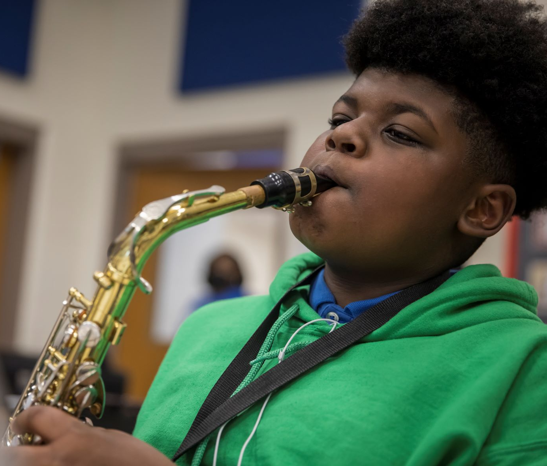

Where we’re going
At our next meeting(s) we will discuss how our data is aligning to our strategic plan and determine if we need to make any adjustments.
Before the end of Fall Semester, we will take Action (vote) on any updates to our strategic plan and the ranking our strategic priorities for the 2024-2025 school year.
Let me or the Chair know of any additional information you need for our future discussion.

Slide 20
Principal’s Report

Slide 21

Security Grant Update
Please update your GO Team on how the $45,000 security grant will be used at your school.

Slide 22
Thank you

